Slide 1

K.RESHMI REDDY 1602-17-737-093
ADITHYA RAMARAJU 1602-17-737-316
A.SANDEEP KUMAR 1602-17-737-101

Slide 2


Slide 3

Abstract
Use cases
Existing System
Proposed System
Modules
Software Requirement
Hardware Requirement
Results
Conclusion and future work

Slide 4

One fundamental issue in today On-line Social Networks (OSNs) is to give users the ability to control the messages posted on their own private space to avoid that unwanted content is displayed. Up to now OSNs provide little support to this requirement. To fill the gap, in this project, we propose a system allowing OSN users to have a direct control on the messages posted on their walls. This is achieved through a flexible rule-based system, that allows users to customize the filtering criteria to be applied to their walls soft classifier automatically labeling messages in support of content-based filtering.

Slide 5
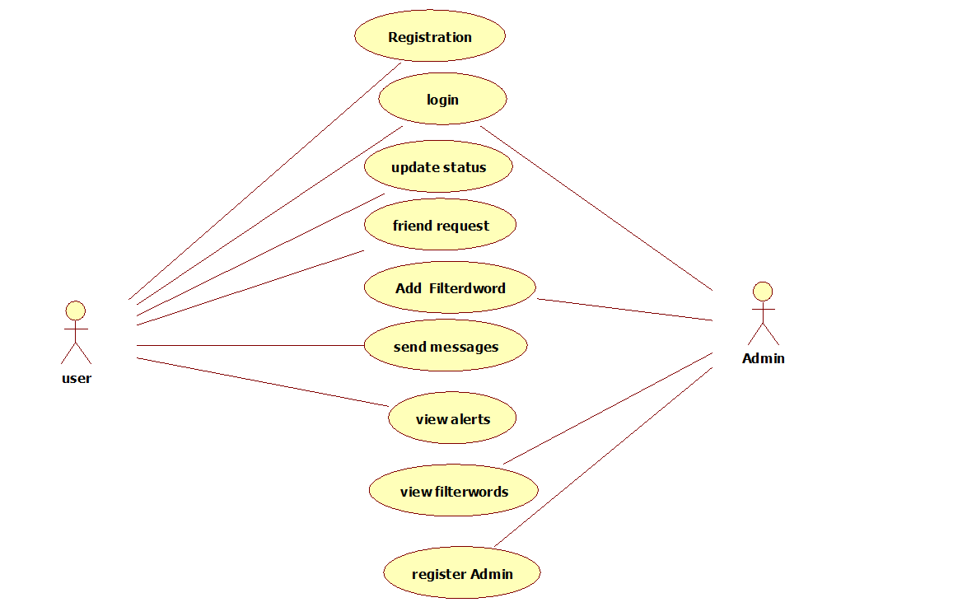

Slide 6

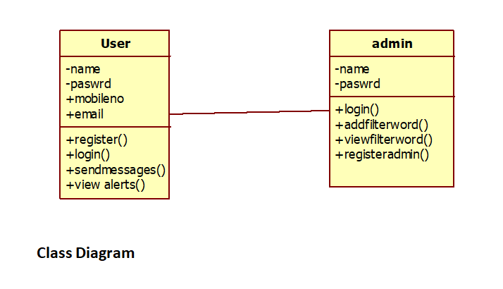

Slide 7

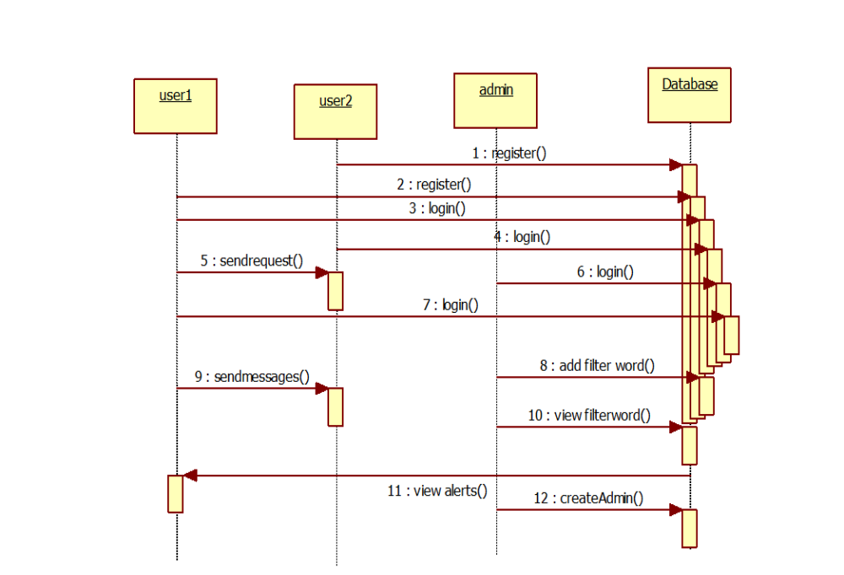

Slide 8

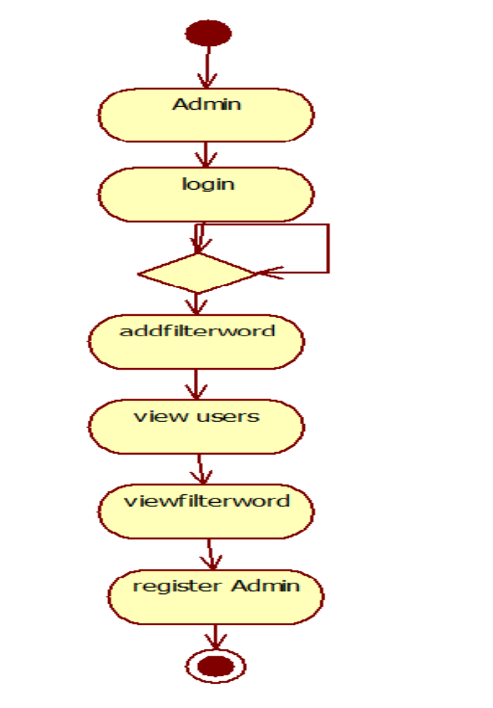

Slide 9

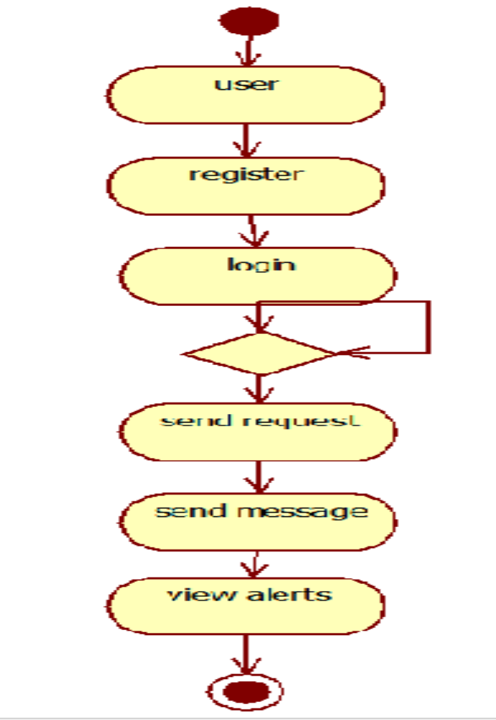

Slide 10

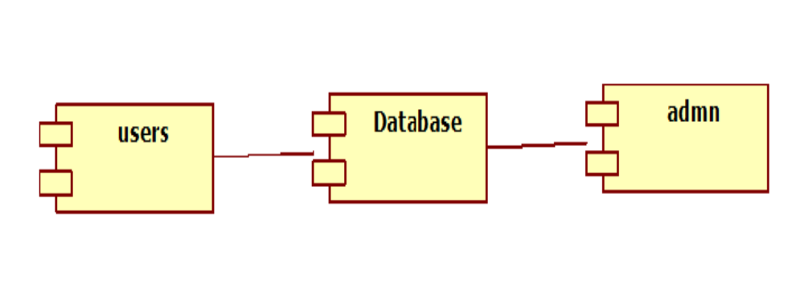

Slide 11

We believe that this is a key OSN service that has not been provided so far.
Indeed, today OSNs provide very little support to prevent unwanted messages on user walls.
However, no content-based preferences are supported and therefore it is not possible to prevent undesired messages, such as political or vulgar ones, no matter of the user who posts them.

Slide 12

The aim of the present work is therefore to propose and experimentally evaluate an automated system, called Filtered Wall (FW), able to filter unwanted messages from OSN user walls.
We exploit text categorization techniques to automatically assign with each short text message a set of categories based on its content.

Slide 13
Filtering rules:
Creators on which a FR applies can be selected on the basis of several different criteria; one of the most relevant is by imposing conditions on their profile’s attributes.
In such a way it is, for instance, possible to define rules applying only to young creators or to creators with a given religious/political view.

Slide 14
Online setup assistant for FRs thresholds:
As mentioned in the previous section, we address the problem of setting thresholds to filter rules, by conceiving and implementing within FW, an Online Setup Assistant (OSA) procedure.
For each message, the user tells the system the decision to accept or reject the message.

Slide 15
Blacklists:
A further component of our system is a BL mechanism to avoid messages from undesired creators, independent from their contents.
To enhance flexibility, such information are given to the system through a set of rules, hereafter called BL rules.

Slide 16

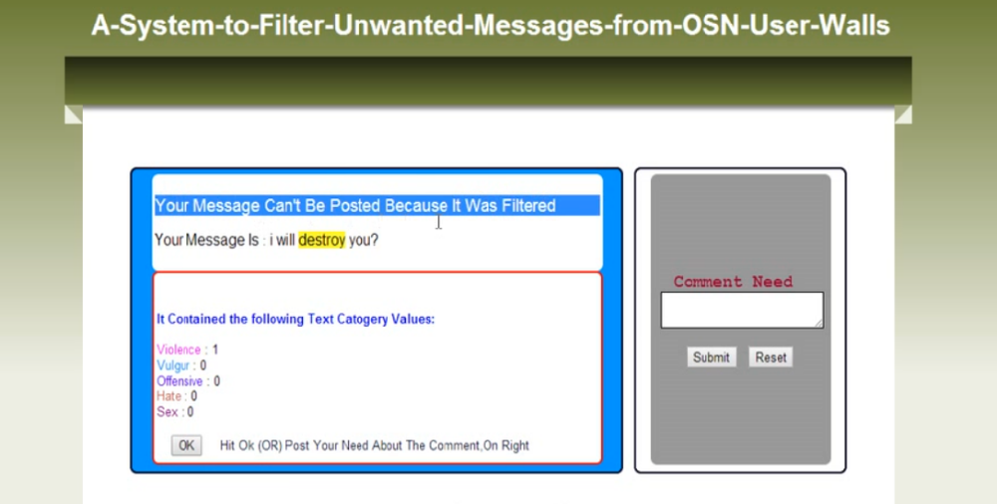

Slide 17

S/W System Configuration:-
Operating System : Windows XP/7/8/10
Web Server : Apache Tomcat 7.0
Database : Mysql5.0
Front End : HTML, Java, Jsp
Scripts : JavaScript.
Database Connectivity : JDBC.

Slide 18

processor - i3
RAM - 1GB
Hard Disk - 80 GB

Slide 19

This project would be still developed in future for recognising images and videos using Artificial Intelligence and it would stop from sending faulty messages and images which disturbs others privacy.It ensure a lot of security for open social network.

Slide 20


